Slide 1

Matrices
إعداد :
فراس سمير سليم
محمد غسان القنبر

Slide 2
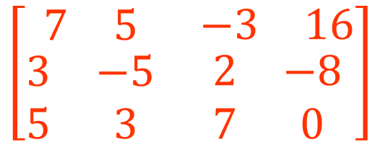
System of linear equations
7x + 5y – 3z = 16
3x – 5y + 2z = -8
5x + 3y – 7z = 0
$$\left[\begin{matrix}\begin{matrix}7 & 5\end{matrix} & \begin{matrix}−3 & 16\end{matrix} \\ \begin{matrix}3 & −5 \\ 5 & 3\end{matrix} & \begin{matrix}2 & −8 \\ 7 & 0\end{matrix}\end{matrix}\right]$$
Augmented matrix

Slide 3
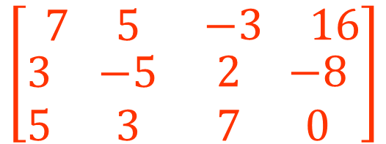
Matrices
$$\left[\begin{matrix}\begin{matrix}7 & 5\end{matrix} & \begin{matrix}−3 & 16\end{matrix} \\ \begin{matrix}3 & −5 \\ 5 & 3\end{matrix} & \begin{matrix}2 & −8 \\ 7 & 0\end{matrix}\end{matrix}\right]$$
We can manipulate this in order to solve the system

Slide 4
Matrices
$$\left[\begin{matrix}\begin{matrix}7 & 5\end{matrix} & \begin{matrix}−3 & 16\end{matrix} \\ \begin{matrix}3 & −5 \\ 5 & 3\end{matrix} & \begin{matrix}2 & −8 \\ 7 & 0\end{matrix}\end{matrix}\right]$$
Terminology
Operations
1) Addition

Slide 5
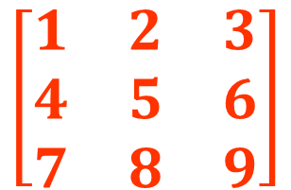
Types of Matrices
$$\left[\begin{matrix}1 & 2 & 3 \\ 4 & 5 & 6 \\ 7 & 8 & 9\end{matrix}\right]$$
m = number of rows
n = number of columns
when m = n the matrix is a square matrix

Slide 6
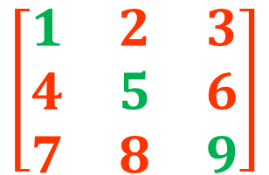
Types of Matrices
square matrix
$$\left[\begin{matrix}1 & 2 & 3 \\ 4 & 5 & 6 \\ 7 & 8 & 9\end{matrix}\right]$$
These numbers comprise the main diagonal

Slide 7
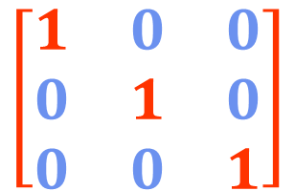
Types of Matrices
diagonal matrix
$$\left[\begin{matrix}1 & 0 & 0 \\ 0 & 1 & 0 \\ 0 & 0 & 1\end{matrix}\right]$$
All the entries off the main diagonal are zero

Slide 8
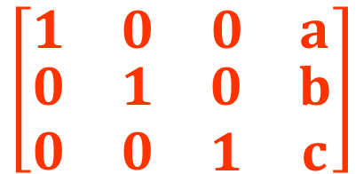
Types of Matrices
augmented matrix
$$\left[\begin{matrix}\begin{matrix}1 & 0\end{matrix} & \begin{matrix}0 & a\end{matrix} \\ \begin{matrix}0 & 1 \\ 0 & 0\end{matrix} & \begin{matrix}0 & b \\ 1 & c\end{matrix}\end{matrix}\right]$$
All the entries off the main diagonal are zero
This situation is the goal of Gauss-Jordan elimination

Slide 9
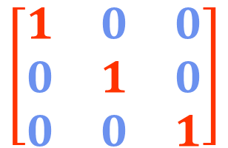
Types of Matrices
diagonal matrix
$$\left[\begin{matrix}1 & 0 & 0 \\ 0 & 1 & 0 \\ 0 & 0 & 1\end{matrix}\right]$$
This is also called an identity matrix

Slide 10
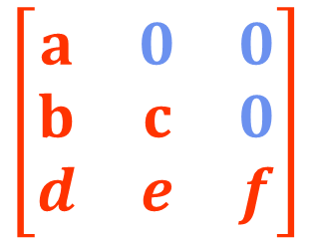
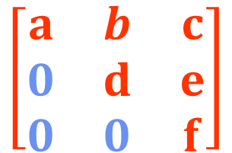
Types of Matrices
Upper triangular matrix
Lower triangular matrix
$$\left[\begin{matrix}a & b & c \\ 0 & d & e \\ 0 & 0 & f\end{matrix}\right]$$
$$\left[\begin{matrix}a & 0 & 0 \\ b & c & 0 \\ d & e & f\end{matrix}\right]$$
Entries below the main diagonal are all zero
Entries above the main diagonal are all zero

Slide 11


Types of Matrices
vector
Row vector
$$\left[\begin{matrix}a \\ b \\ c\end{matrix}\right]$$
$$\left[\begin{matrix}a & b & c\end{matrix}\right]$$
Matrix consisting of just one column
The more common usage of “vector”
Matrix consisting of just one row

Slide 12
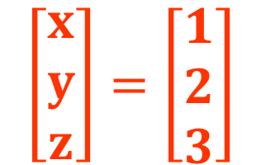
Types of Matrices
vector
$$\left[\begin{matrix}x \\ y \\ z\end{matrix}\right]=\left[\begin{matrix}1 \\ 2 \\ 3\end{matrix}\right]$$
We can list system solutions as a vector

Slide 13
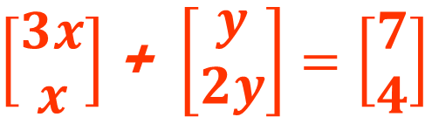
Types of Matrices
3x + y = 7
X +2y = 4
Systems of linear equations can be represented with vectors
$\left[\begin{matrix}3x \\ x\end{matrix}\right]$ + $\left[\begin{matrix}y \\ 2y\end{matrix}\right]=\left[\begin{matrix}7 \\ 4\end{matrix}\right]$

Slide 14
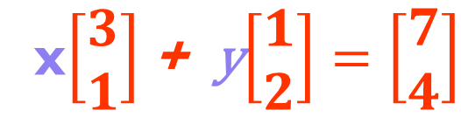
Types of Matrices
3x + y = 7
X +2y = 4
Systems of linear equations can be represented with vectors
x$\left[\begin{matrix}3 \\ 1\end{matrix}\right]$ + y$\left[\begin{matrix}1 \\ 2\end{matrix}\right]=\left[\begin{matrix}7 \\ 4\end{matrix}\right]$

Slide 15
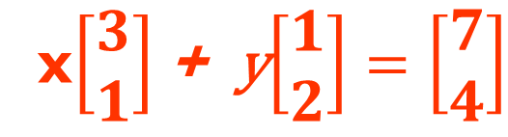
Types of Matrices
3x + y = 7
X +2y = 4
Systems of linear equations can be represented with vectors
x$\left[\begin{matrix}3 \\ 1\end{matrix}\right]$ + y$\left[\begin{matrix}1 \\ 2\end{matrix}\right]=\left[\begin{matrix}7 \\ 4\end{matrix}\right]$

Slide 16
Types of Matrices
3x + y = 7
X +2y = 4
This is the vector form of the linear system
x$\left[\begin{matrix}3 \\ 1\end{matrix}\right]$ + y$\left[\begin{matrix}1 \\ 2\end{matrix}\right]=\left[\begin{matrix}7 \\ 4\end{matrix}\right]$

Slide 17
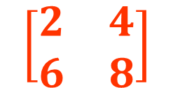
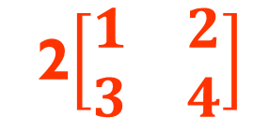
Scalar Multiplication With Matrices
2$\left[\begin{matrix}1 & 2 \\ 3 & 4\end{matrix}\right]$
when multiplying a matrix by a scalar we multiply each entry by the scalar
$$\left[\begin{matrix}2 & 4 \\ 6 & 8\end{matrix}\right]$$

Slide 18
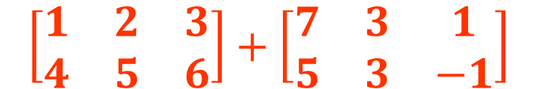
Performing Matrix Addition and Subtracting
$$\left[\begin{matrix}1 & 2 & 3 \\ 4 & 5 & 6\end{matrix}\right]+\left[\begin{matrix}7 & 3 & 1 \\ 5 & 3 & −1\end{matrix}\right]$$
For matrices to be added together they must have identical dimensions

Slide 19

Performing Matrix Addition and Subtracting
$$\left[\begin{matrix}1 & 2 & 3 \\ 4 & 5 & 6\end{matrix}\right]+\left[\begin{matrix}7 & 3 & 1 \\ 5 & 3 & −1\end{matrix}\right]$$
Each entry in the new matrix is the sum of the corresponding entries
=

Slide 20
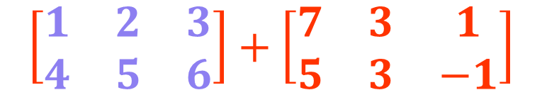
Performing Matrix Addition and Subtracting
$$\left[\begin{matrix}1 & 2 & 3 \\ 4 & 5 & 6\end{matrix}\right]+\left[\begin{matrix}7 & 3 & 1 \\ 5 & 3 & −1\end{matrix}\right]$$
Each entry in the new matrix is the sum of the corresponding entries
=

Slide 21
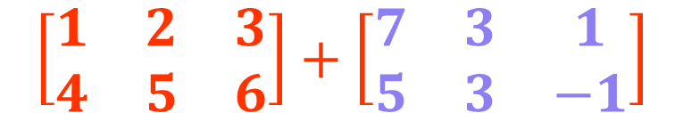
Performing Matrix Addition and Subtracting
$$\left[\begin{matrix}1 & 2 & 3 \\ 4 & 5 & 6\end{matrix}\right]+\left[\begin{matrix}7 & 3 & 1 \\ 5 & 3 & −1\end{matrix}\right]$$
Each entry in the new matrix is the sum of the corresponding entries
=

Slide 22
Performing Matrix Addition and Subtracting
$$\left[\begin{matrix}1 & 2 & 3 \\ 4 & 5 & 6\end{matrix}\right]+\left[\begin{matrix}7 & 3 & 1 \\ 5 & 3 & −1\end{matrix}\right]$$
Each entry in the new matrix is the sum of the corresponding entries
=

Slide 23
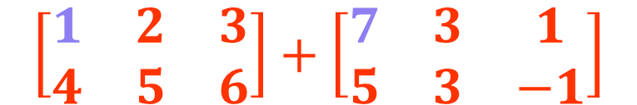

Performing Matrix Addition and Subtracting
$$\left[\begin{matrix}1 & 2 & 3 \\ 4 & 5 & 6\end{matrix}\right]+\left[\begin{matrix}7 & 3 & 1 \\ 5 & 3 & −1\end{matrix}\right]$$
Each entry in the new matrix is the sum of the corresponding entries
= $\left[\begin{matrix}8 & & \\ & & \end{matrix}\right]$

Slide 24

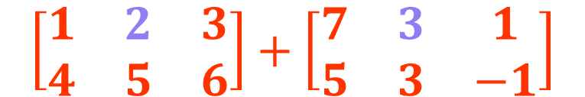
Performing Matrix Addition and Subtracting
$$\left[\begin{matrix}1 & 2 & 3 \\ 4 & 5 & 6\end{matrix}\right]+\left[\begin{matrix}7 & 3 & 1 \\ 5 & 3 & −1\end{matrix}\right]$$
Each entry in the new matrix is the sum of the corresponding entries
= $\left[\begin{matrix}8 & 5 & \\ & & \end{matrix}\right]$

Slide 25
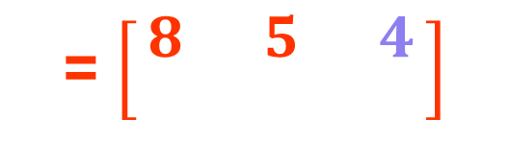
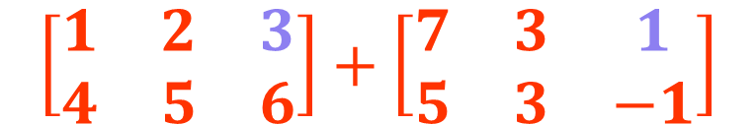
Performing Matrix Addition and Subtracting
$$\left[\begin{matrix}1 & 2 & 3 \\ 4 & 5 & 6\end{matrix}\right]+\left[\begin{matrix}7 & 3 & 1 \\ 5 & 3 & −1\end{matrix}\right]$$
Each entry in the new matrix is the sum of the corresponding entries
= $\left[\begin{matrix}8 & 5 & 4 \\ & & \end{matrix}\right]$

Slide 26
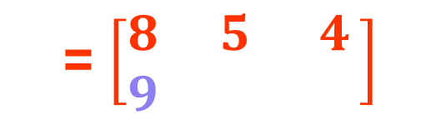
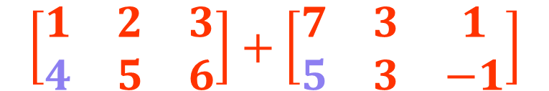
Performing Matrix Addition and Subtracting
$$\left[\begin{matrix}1 & 2 & 3 \\ 4 & 5 & 6\end{matrix}\right]+\left[\begin{matrix}7 & 3 & 1 \\ 5 & 3 & −1\end{matrix}\right]$$
Each entry in the new matrix is the sum of the corresponding entries
= $\left[\begin{matrix}8 & 5 & 4 \\ 9 & & \end{matrix}\right]$

Slide 27
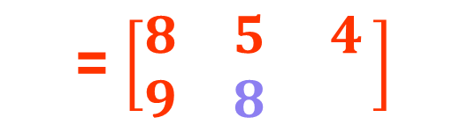
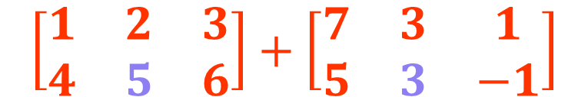
Performing Matrix Addition and Subtracting
$$\left[\begin{matrix}1 & 2 & 3 \\ 4 & 5 & 6\end{matrix}\right]+\left[\begin{matrix}7 & 3 & 1 \\ 5 & 3 & −1\end{matrix}\right]$$
Each entry in the new matrix is the sum of the corresponding entries
= $\left[\begin{matrix}8 & 5 & 4 \\ 9 & 8 & \end{matrix}\right]$

Slide 28
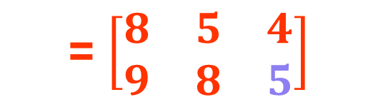
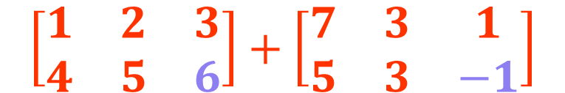
Performing Matrix Addition and Subtracting
$$\left[\begin{matrix}1 & 2 & 3 \\ 4 & 5 & 6\end{matrix}\right]+\left[\begin{matrix}7 & 3 & 1 \\ 5 & 3 & −1\end{matrix}\right]$$
Each entry in the new matrix is the sum of the corresponding entries
= $\left[\begin{matrix}8 & 5 & 4 \\ 9 & 8 & 5\end{matrix}\right]$

Slide 29
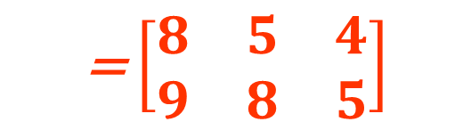
Performing Matrix Addition and Subtracting
$$\left[\begin{matrix}1 & 2 & 3 \\ 4 & 5 & 6\end{matrix}\right]+\left[\begin{matrix}7 & 3 & 1 \\ 5 & 3 & −1\end{matrix}\right]$$
Each entry in the new matrix is the sum of the corresponding entries
= $\left[\begin{matrix}8 & 5 & 4 \\ 9 & 8 & 5\end{matrix}\right]$

Slide 30
Performing Matrix Addition and Subtracting
$$\left[\begin{matrix}1 & 2 & 3 \\ 4 & 5 & 6\end{matrix}\right]+\left[\begin{matrix}7 & 3 & 1 \\ 5 & 3 & −1\end{matrix}\right]$$
These had to have identical dimensions for the addition to work properly
= $\left[\begin{matrix}8 & 5 & 4 \\ 9 & 8 & 5\end{matrix}\right]$

Slide 31
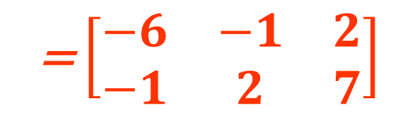
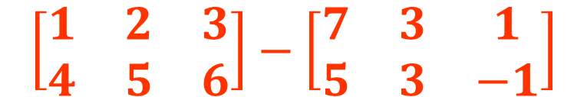
Performing Matrix Addition and Subtracting
$$\left[\begin{matrix}1 & 2 & 3 \\ 4 & 5 & 6\end{matrix}\right]−\left[\begin{matrix}7 & 3 & 1 \\ 5 & 3 & −1\end{matrix}\right]$$
Matrix subtraction is very similar to matrix addition
= $\left[\begin{matrix}−6 & −1 & 2 \\ −1 & 2 & 7\end{matrix}\right]$

Slide 32
Performing Matrix Addition and Subtracting
Matrix addition is commutative
A + B = B + A
Matrix subtraction is NOT commutative
A - B ≠ B - A

Slide 33
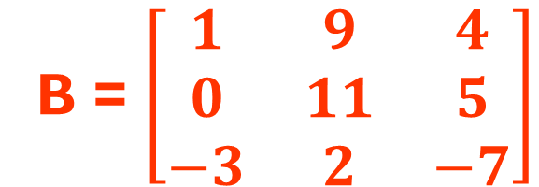
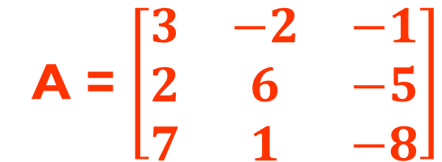
Checking Comprehension
A = $\left[\begin{matrix}3 & −2 & −1 \\ 2 & 6 & −5 \\ 7 & 1 & −8\end{matrix}\right]$
B = $\left[\begin{matrix}1 & 9 & 4 \\ 0 & 11 & 5 \\ −3 & 2 & −7\end{matrix}\right]$
Find A + B:
Find A - B :

Slide 34
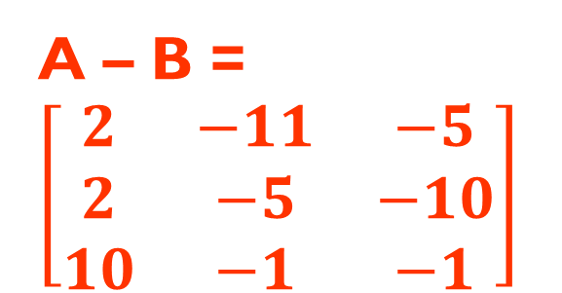
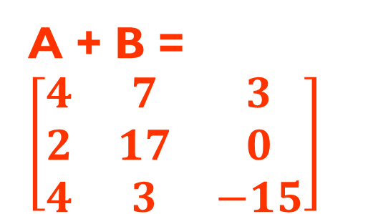
Checking Comprehension
A = $\left[\begin{matrix}3 & −2 & −1 \\ 2 & 6 & −5 \\ 7 & 1 & −8\end{matrix}\right]$
B = $\left[\begin{matrix}1 & 9 & 4 \\ 0 & 11 & 5 \\ −3 & 2 & −7\end{matrix}\right]$
Find A + B:
Find A - B :
A + B = $\left[\begin{matrix}4 & 7 & 3 \\ 2 & 17 & 0 \\ 4 & 3 & −15\end{matrix}\right]$
A – B = $\left[\begin{matrix}2 & −11 & −5 \\ 2 & −5 & −10 \\ 10 & −1 & −1\end{matrix}\right]$

